Slide 1
WK03: Data Engineering
Enabling Scalable, Reliable, and Efficient Data Pipelines
PPOL 5206: Spring 2025

Slide 2
The Value of DE
The value gained from data depends on two things:
  Data accuracy
  Data access efficiency
Ensuring accuracy and access is the role of DE
DE’s goal is to make quality data available for fact-finding and data-driven decision

Slide 3
What is DE
DE provides the support materials for Data Science (DS) and Business Intelligence (BI)
DE enables:
  Collection
  Transformation
  Storage
Well-structured DE pipelines ensure:
  Structure
  Accessibility
  Usability

Slide 4
A DE Definition
“Data engineering is the development, implementation, and maintenance of systems and processes that take in raw data and produce high-quality, consistent information that supports downstream use cases, such as analysis and machine learning.
Data engineering is the intersection of security, data management, DataOps, data architecture, orchestration, and software engineering.
A data engineer manages the data engineering lifecycle, beginning with getting data from source systems and ending with serving data for use cases, such as analysis or machine learning.”
- Fundamentals of Data Engineering, pg 4

Slide 5
The Modern Data Ecosystem
A network of interconnected, independent, and continually evolving entities
Data to be integrated from disparate sources
Different types of analysis and skills to generate insights
Stakeholders who collaborate and act on insights generated
Tools, applications, and infrastructure to store, process, and disseminate data

Slide 6
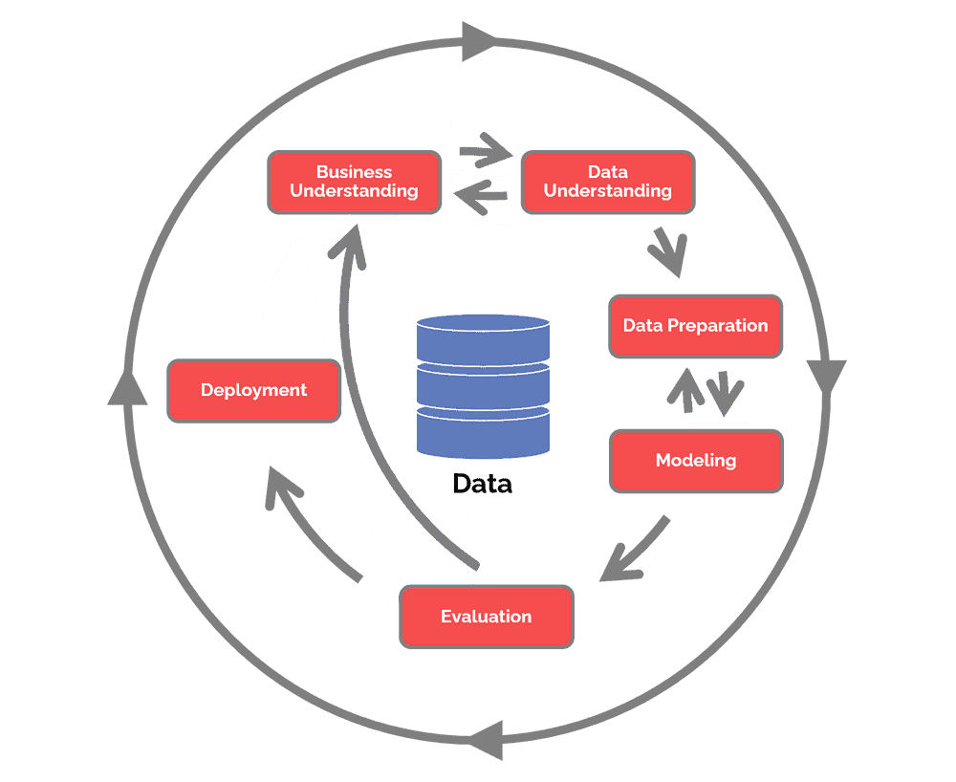
CRISP – DM Data Analysis Framework
(Cross-industry standard process for data mining)

Slide 7
CRISP-DM Stages
Business Understanding:
  Define project objectives.
Data Understanding:
  Explore data sources and quality.
Data Preparation:
  Clean, transform, and structure data.
Modeling:
  Apply transformations and prepare for analysis.
Evaluation:
  Ensure data meets quality and business needs.
Deployment:
  Integrate into a production pipeline.

Slide 8
DS and DE
Data Scientists analyze and model data.
Data Engineers build pipelines to make structured data available.
Collaboration is key to delivering valuable insights.
To do correct work as a DS, you need to understand the provenance of the data including
  Sources
  Data generation and gathering methods
  Any edits or cleaning performed on the data

Slide 9
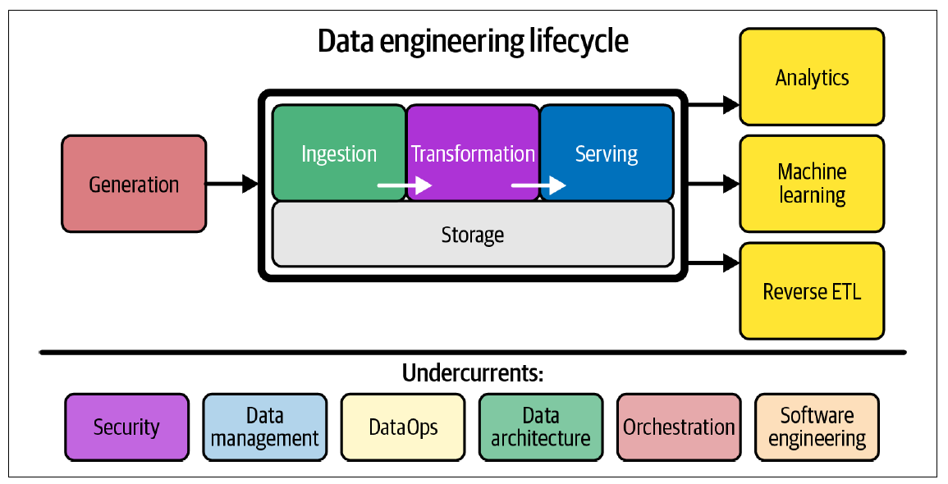
The Data Engineering Lifecycle
Fundamentals of Data Engineering, pg 5

Slide 10
The Data Engineering Ecosystem
Data pipelines:
  Gather data from multiple sources, transform it into analytics-ready data, and make it available to data consumers for analytics and decision-making.
Data repositories:
  Relational and non-relational databases, data warehouses, data marts, data lakes, and big data stores process and store this data.
Data integration:
  Platforms combine disparate data into a unified view for the data consumers.

Slide 11
Data Pipelines
A sequence of automated steps that move and transform data
Stages:
  Generation:
    Data are created by the generating process
  Ingestion:
    Extract data from APIs, files, and databases (e.g., data lake, S3, Kafka).
  Transformation/Processing:
    Clean and transform data (e.g., AWS Glue, Spark).
  Storage:
    Save processed data (e.g., data warehouse, RDS, Redshift, Snowflake).
  Consumption:
    Provide data for the end user, (e.g. analytics and AI).

Slide 12
1) Ingestion
Data are available:
  in a variety of structured and unstructured datasets,
  residing in text, images, videos, clickstreams, user conversations, social media platforms, the Internet of Things devices, real-time events that stream data, legacy databases, and data sourced from professional data providers and agencies.
When working with different sources of data,
  The first step is to pull a copy of the data from the original sources into a data repository
  At this stage, only looking at acquiring the data you need
  Working with data formats, sources, and interfaces through which this data can be pulled in.
  Reliability, security, and integrity of the data being acquired are some of the challenges at this stage.

Slide 13
2) Transformation/Processing
Data needs to be organized, cleaned up, and optimized for access by end-users.
The data also needs to conform to compliances and standards enforced in the organization
  For example, conforming to guidelines that regulate the storage and use of personal data such as health, biometrics, or household data in the case of IoT devices.
  Adhering to master data tables within the organization, to ensure standardization of master data across all applications and systems of an organization, is another example.
The key challenges at this stage could involve data management and working with data repositories that provide high availability, flexibility, accessibility, and security.

Slide 14
3) Serving
Making data available in the enterprise repository for use by
  Business stakeholders
  Applications
  Programmers
  Analysts
  Data scientists
Key challenges at this stage could include:
  Interfaces
  APIs
  Applications
For example, Data Analysts may need the raw data to work with. Business stakeholders may need reports and dashboards. Applications may need custom APIs to pull this data.

Slide 15
AWS Services for Data Engineering
Amazon S3: Scalable object storage for raw and processed data.
AWS Glue: Managed ETL service for data transformation.
Amazon RDS: Relational database service for structured data.
Amazon Redshift: Data warehouse for analytics.
AWS Lambda: Serverless compute for automation.
Amazon Kinesis: Real-time data streaming.
AWS Step Functions: Workflow orchestration.
AWS Athena: Serverless SQL Querying

Slide 16
1. Ingestion

Slide 17
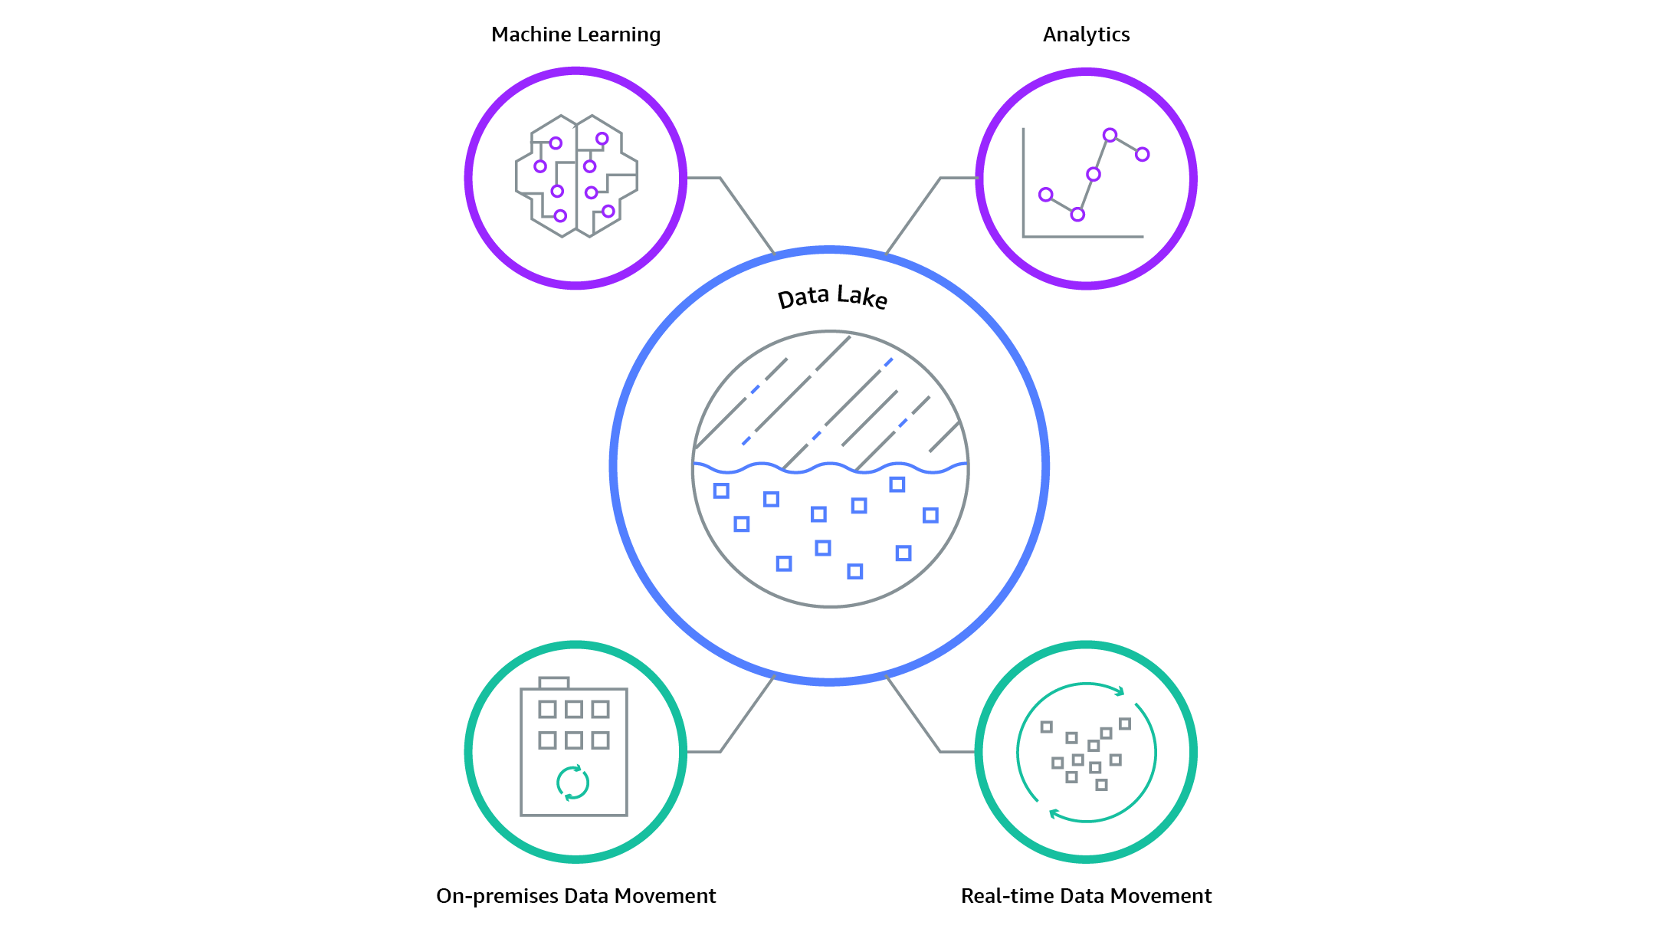
What is a Data Lake
Centralized repository that allows storage of structured and unstructured data at any scale
Store data as is, without need for processing, advanced organization, or visual analytics prior to ingestion
Notes:
Data Lakes are for all types of data. Contrast them with Data Warehouses.
Similar to how we contrasted OLTP and OLAP warehouses
A data lake is usually a large, centralized repository for storing raw, unprocessed data in its native format.
It can store structured, semi-structured, and unstructured data from various sources, such as social media, IoT devices, log files, and more.
The primary goal of a data lake is to provide a scalable and cost-effective storage solution that enables easy access and analysis of data.
On the other hand, a data warehouse is a more structured repository designed for storing, managing, and analyzing processed and structured data.
It is optimized for complex queries and reporting, using schemas (such as star or snowflake schemas) and
is usually built on top of traditional relational databases or specialized columnar storage systems.

Slide 18
Data Warehouse vs Data Lake
Characteristics | Data Warehouse (Serving) | Data Lake (Ingestion)
Data | Relational from transactional systems, operational databases, and line of business applications | Non-relational and relational from IoT devices, web sites, mobile apps, social media, and corporate applications
Schema | Designed prior to the DW implementation (schema-on-write) | Written at the time of analysis (schema-on-read)
Price/Performance | Fastest query results using higher cost storage | Query results getting faster using low-cost storage
Data Quality | Highly curated data that serves as the central version of the truth | Any data that may or may not be curated (ie. raw data)
Users | Business analysts | Data scientists, Data developers, and Business analysts (using curated data)
Analytics | Batch reporting, BI and visualizations | Machine Learning, Predictive analytics, data discovery and profiling
Notes:
The main differences between a data lake and a data warehouse are:
Data storage: Data lakes store raw data in its native format, while data warehouses store processed and structured data.
Data processing: Data lakes enable schema-on-read (i.e., data is structured during analysis), while data warehouses use schema-on-write (i.e., data is structured before storage).
Data types: Data lakes can handle structured, semi-structured, and unstructured data, while data warehouses are optimized for structured data.
Query performance: Data warehouses are designed for fast and efficient querying, while data lakes might require additional processing to optimize query performance.
Scalability: Data lakes are typically more scalable and cost-effective, while data warehouses may require more resources to scale.
Data May not be put into a Warehouse until its use has been defined as it is often structured for a specific analysis.

Slide 19
Benefits of Data Lakes
Ability to harness more data, from more sources, in less time
More flexibility to analyze data in different ways
Improved customer interactions
Improved R&D
Increase operational efficiencies

Slide 20
Challenges of Data Lakes
Raw data is stored with no oversight of contents.
Lack of tracking and knowledge base
Data Swamp
Notes:
Moving to a data warehouse can help formalize the structure.
Uses of Data warehouses:
1. Business Intelligence (BI) reporting: Running complex queries to generate reports and visualizations that inform decision-making and help identify trends, patterns, and anomalies in data.
2. Data consolidation: Integrating data from various sources into a single, structured format for easier analysis and reporting.
3. Predictive analytics: Using historical data stored in a data warehouse to build predictive models that can help forecast future trends, customer behaviors, or product performance.

Slide 21
Formatting and Organizing Files in Data Lakes
Consistent Format: All files in an S3 path being crawled should be of the same format.
Consistent Schema: Within a given folder or prefix, files should have a consistent schema.
File Organization: It's often a good practice to partition your data. A common way is by using a folder structure such as s3://your-bucket/year=2021/month=07/day=15/ .
Avoid Mixed Use: Avoid mixing raw data, processed data, and various stages of data within the same S3 path. It's better to separate raw data from processed data by using different prefixes or even different buckets.
Avoid Frequent Schema Changes: If the schema of your data changes frequently, it can lead to complications when crawling. It's best to have stable schemas for locations that are being crawled.

Slide 22
2. Transformation/Processing

Slide 23
What is ETL?
EXTRACT data from its original source
TRANSFORM data by duplicating it, combining it, and ensuring its quality
LOAD data into the target database

Slide 24
Extraction
Before data can be moved, it must first be extracted from its source – such as a data warehouse or data lake. Volumes of data can be extracted from a wide range of sources, including:
Existing databases or legacy systems
Cloud or on-premise environments
Applications
CRM systems
Other data storage platforms

Slide 25
Transformation
Data transformation is comprised of several sub-processes:
Cleaning
Standardizing
Deduplication (removing redundant data)
Verifying
Sorting
Depending on the needs of your business, more transformation tasks may be required

Slide 26
Loading
The final step in the ETL process is loading newly transform data into a destination. Data can be loaded all at once, or in increments
Full load
  Everything that comes from the transformation process goes into new records in target data repository
Incremental loading
  Adds only new or updated record from source database into target database

Slide 27
ETL Solutions
2 Options:
Develop organic ETL through hard-coding
Flexible, more familiar
Use an ETL tool
Faster, more cost-effective

Slide 28
Why use an ETL Tool?
Hard-coding ETL solutions is laborious and error prone, and becomes increasingly difficult as:
Data formats change
Data sources are added
Data volume grows
Target schemas change

Slide 29
Why use an ETL Tool?
AWS Glue automates the heavy lifting of ETL
Automatically discover and categorize your data making for easy searching and querying across sources
Generate code to clean, enrich, and move data between various sources
Run jobs on serverless, fully manages, scalable environments

Slide 30
ETL vs ELT
Extract – Transform – Load
Extract – Load – Transform
Transforms data on separate processing server
Raw data not in data warehouse
Slower data ingestion
Better privacy controls
More systems/maintenance
Structured data output
Transforms data in data warehouse
Raw data pulled into data warehouse
Faster Data Ingestion
Raw Data as historical archive
Fewer systems/maintenance
Structured or unstructured output
Cloud tools, including scalability, parallel processing, and security controls can reduce the differences in performance between the two methods.

Slide 31
AWS ETL (or ELT) from Lake to Warehouse
Extract:
  Data is ingested into S3 in raw formats (CSV, JSON, Parquet).
Transform:
  AWS Glue cleans, joins, and aggregates data.
Load:
  The transformed data is stored in Amazon RDS.
Overall Orchestration:
  Lambda or Step Functions automate ETL execution.

Slide 32
AWS Glue Components
Data Catalog
Hive Metastore compatible with enhanced functionality
Crawlers automatically extract metadata and create tables
Integrated with Athena and Redshift for analytics and warehousing
Job Authoring
auto-generates ETL code
Build on open frameworks: Python and Spark
Developer-centric: editing, debugging, sharing
Job execution
Run jobs on serverless Spark platform
Provides flexible scheduling
Handles dependency resolution, monitoring and alterting

Slide 33
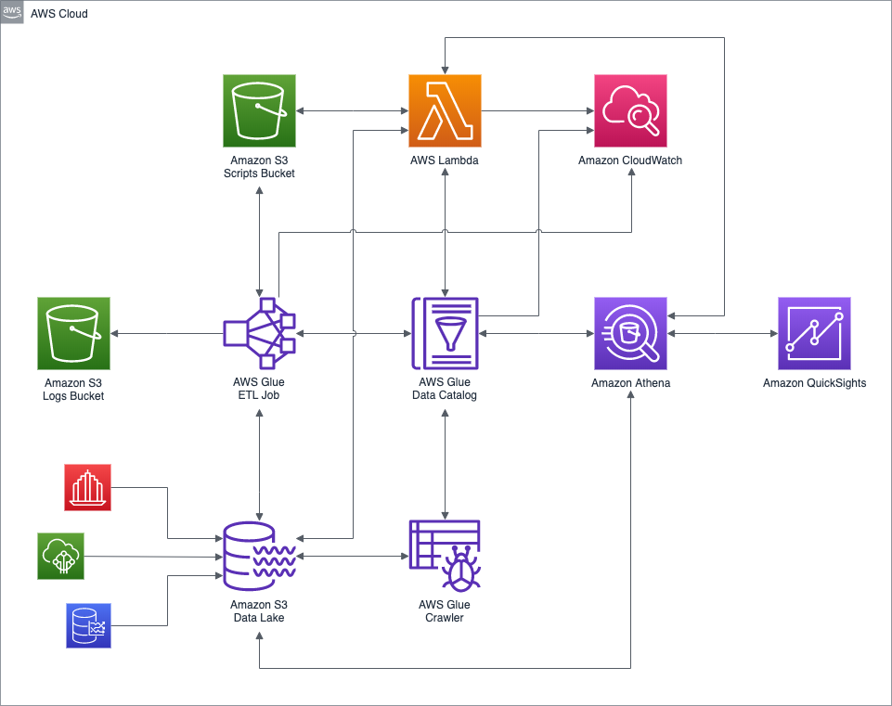
Glue Use Case

Slide 34
What is a data catalog?
Centralized Metadata repository
Data about data
Data definitions, lineage, quality information, etc.
Data lineage:
Where it comes from, how its transformed, how it’s used
Useful for audit trails and compliance
Searchable: allowing users to find and manage data across an organization
Quality: Data profiling features can assess quality, identify data issues, increasing accuracy and consistency
Access control: Protect sensitive or regulated data
Supports consistency across different data sets by controlling data definitions and business glossary
Supports data governance and lineage, helping ensure compliance with regulations

Slide 35
Crawlers
Automatically discover new data and extract schema definitions
Built-in classifiers for popular types
Run as needed, or on a schedule (only pay when crawler runs)

Slide 36
New: Glue Studio
Visual Interface: AWS Glue Studio offers a drag-and-drop editor where you can visually create, edit, and manage ETL jobs. This interface makes it easier to understand the data flow and the transformations being applied.
Code and Notebook Options: AWS Glue Studio also supports scripting via an integrated code editor and Jupyter notebooks. This can benefit users who want more control over their ETL logic or wish to use complex algorithms that are easier to implement in code.
Interactive Sessions: The platform supports interactive sessions, allowing data engineers to experiment with and prepare data in a more hands-on manner. This feature is particularly useful for iterative development and testing of ETL processes.
Serverless Operation: AWS Glue Studio runs in a serverless environment managed by AWS, which means users do not have to manage the underlying infrastructure. The service scales automatically depending on the workload, optimizing resource usage and cost.
Integration with AWS Services: It integrates seamlessly with other AWS services.

Slide 37
3. Serving

Slide 38
Athena
AWS Solution to building ETL Pipelines

Slide 39
AWS Athena
Serverless system used to analyze data directly from S3 buckets
Uses standard SQL
Supports wide range of file formats
Csv, json, parquet, apache orc etc…

Slide 40
Athena Integrations
S3
Data comes directly from buckets
Glue
Glue crawlers create catalog – which creates tables for athena to query
Quicksight
Data Visualization tool (will be discussed later in course!)

Slide 41
Athena use cases
Since data comes from S3, you can analyze all log files that comes from other AWS services
Integration with other, local visualization tools through ODBC/JDBC
Quick, efficient, ad-hoc analysis

Slide 42
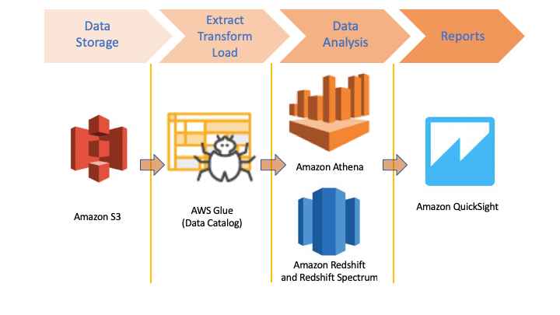
Athena

Slide 43
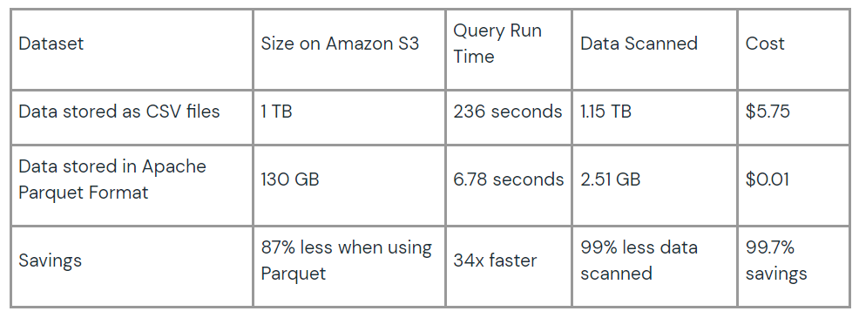
Apache Parquet Files
Columnar vs row format
Optimized for large OLAP DBs
Source: https://www.databricks.com/glossary/what-is-parquet

Slide 44
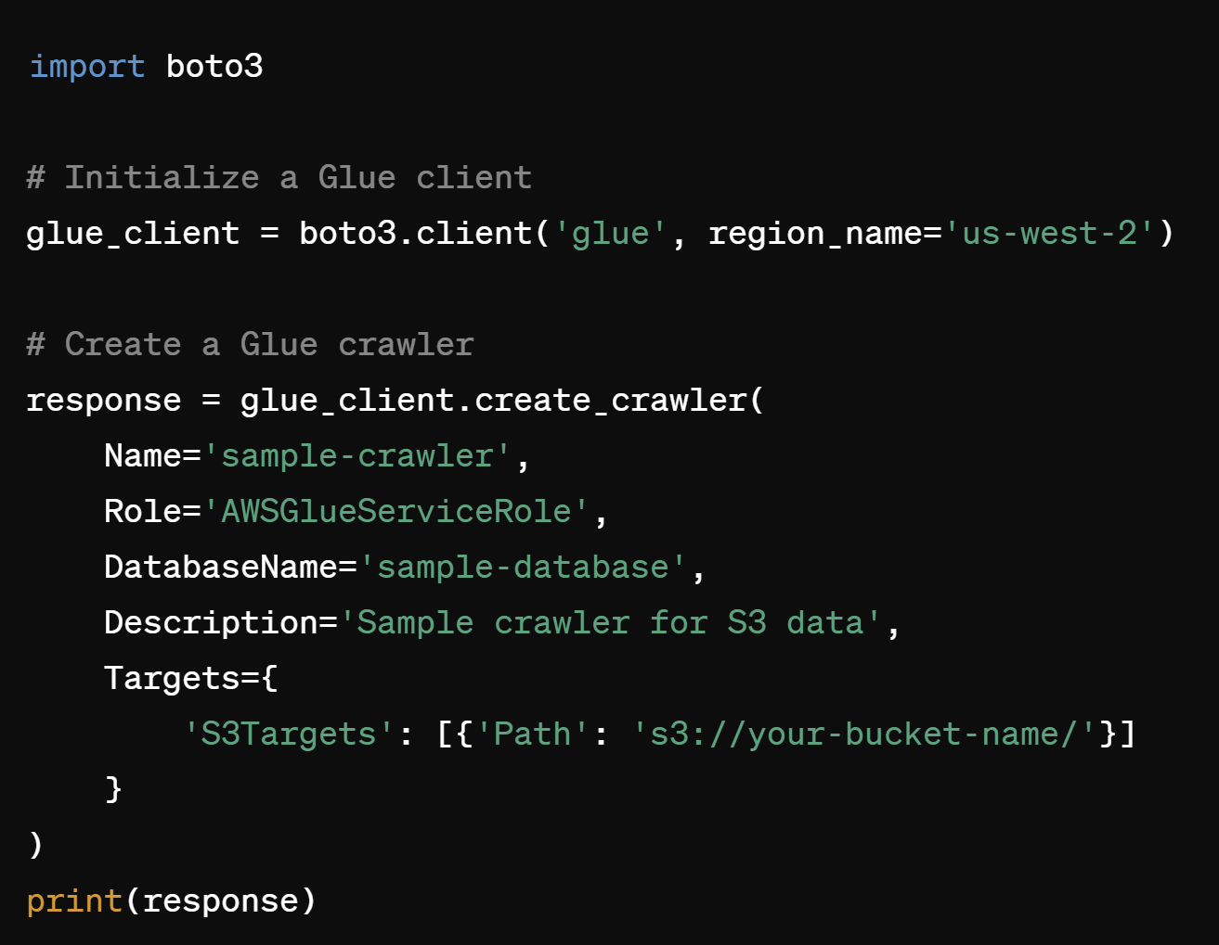
Boto3 + Glue

Slide 45
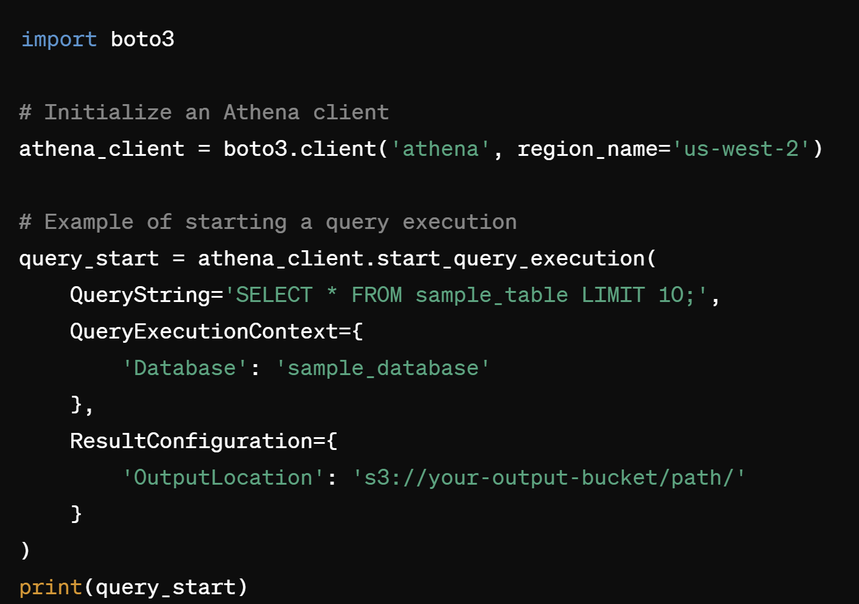
Boto3 + Athena

Slide 46
Takeaways
DE ensures data accuracy and access
The DE lifecycle covers stages from ingestion, processing, and serving data
DE is tightly connected to the entire data analysis framework

Slide 47
Next Week
SQL
Structured Data

